Slide 1
Preferences
Optimal climate policy depends on how we define better and best
We may want to take advise from Socrates, Jesus, Mohammed, Lao Tzu, Johnny Rotten, Lord Stern or Lady Gaga
We may also want to measure people’s
time preference
risk aversion
inequity aversion
But how?

Slide 2
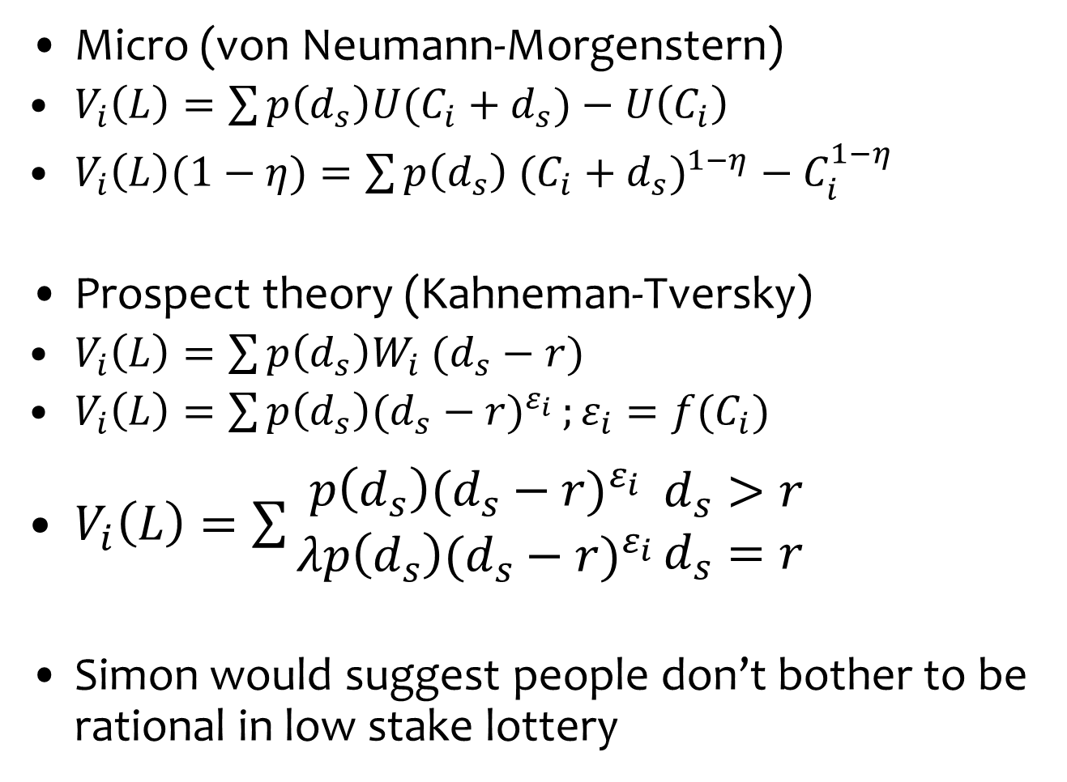
Risk preference
Micro (von Neumann-Morgenstern)
$V_{i}\left(L\right)=\sum{p\left(d_{s}\right)U(C_{i}+d_{s})}−U\left(C_{i}\right)$
$V_{i}\left(L\right)(1−η)=\sum{p\left(d_{s}\right) {(C_{i}+d_{s})}^{1−η}}−C_{i}^{1−η}$
Prospect theory (Kahneman-Tversky)
$V_{i}\left(L\right)=\sum{p\left(d_{s}\right)W_{i} (d_{s}−r)}$
$V_{i}\left(L\right)=\sum{p\left(d_{s}\right){(d_{s}−r)}^{ε_{i}}};ε_{i}=f(C_{i})$
$V_{i}\left(L\right)=\sum{\begin{matrix}p\left(d_{s}\right){(d_{s}−r)}^{ε_{i}} \\ λp\left(d_{s}\right){(d_{s}−r)}^{ε_{i}}\end{matrix}}\begin{matrix}d_{s}>r \\ d_{s}=r\end{matrix}$
Simon would suggest people don’t bother to be rational in low stake lottery

Slide 3
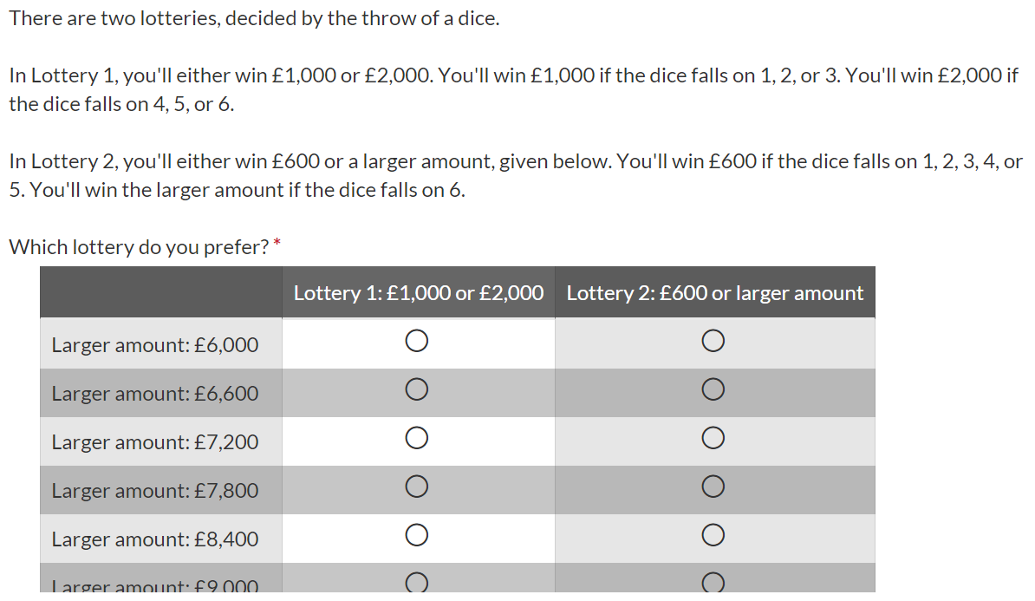
Ask for choice between two lotteries because people
may be biased towards sure things.

Slide 4
If someone accepts Lottery 2 for £6000, then she must be
risk neutral or risk loving.
If someone on an income of £29000 per year rejects
Lottery 2 for £6600, then her risk aversion aversion
must be smaller than 1.4.
If she rejected Lottery 2 for £6000, then her risk
aversion lies between 0.0 and 1.4.

Slide 6
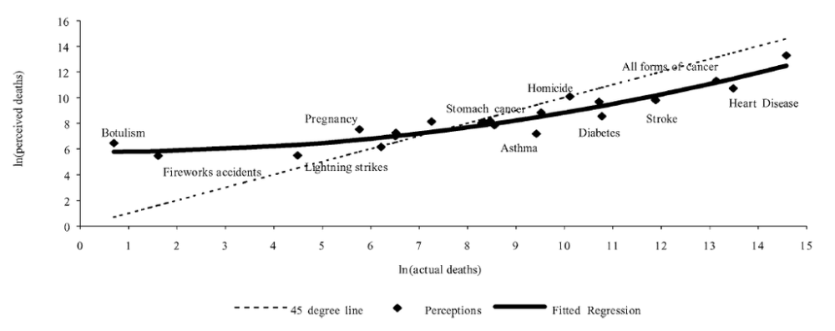

Slide 7
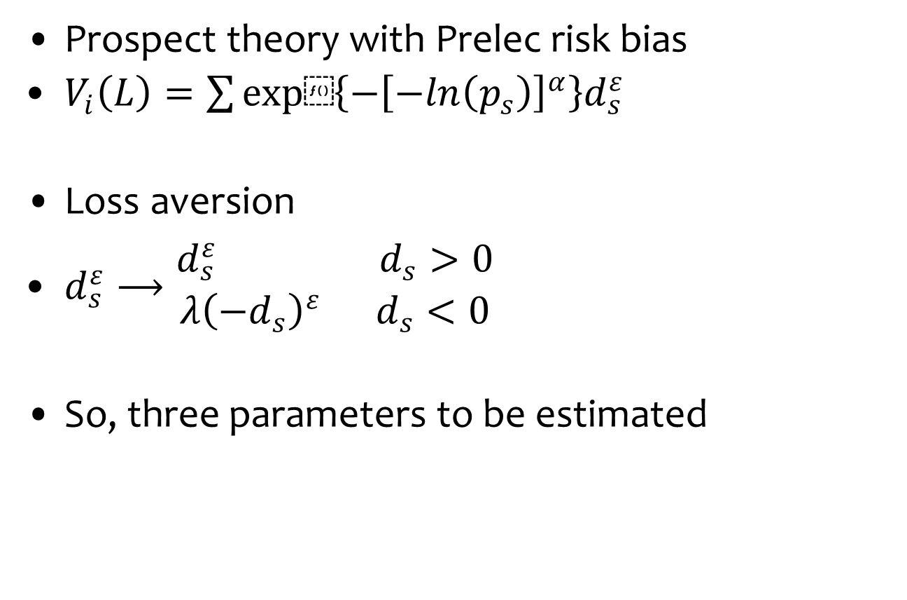
Risk preference
Prospect theory with Prelec risk bias
$V_{i}\left(L\right)=\sum{exp⁡\left\{−{\left[−ln\left(p_{s}\right)\right]}^{α}\right\}d_{s}^{ε}}$
Loss aversion
$d_{s}^{ε}⟶\begin{matrix}d_{s}^{ε} d_{s}>0 \\ λ{\left(−d_{s}\right)}^{ε} d_{s}<0\end{matrix}$
So, three parameters to be estimated

Slide 8
Time preference

Slide 9
Time preference

Slide 10



Time preference
$$DF={β\left(1−\left(1−θ\right)rt\right)}^{1/{1−θ}}$$
$$DF=e^{−rt},β=θ=1$$
$$DF={\left(1+rt\right)}^{−1},β=1 and θ=2$$

Slide 11
Time preference
Benhabib, Bisin & Schotter (2010, GEB) discount function has 3 parameters
Voors et al., AER, 2012
Discrete choice, 6 alternatives
1 period, 1 sum: 1 observation per person
Tanaka et al., AER, 2010
Discrete choice, 5 alternatives
3 periods, 5 sums: 15 obs/person, 5 obs/par
Ifcher & Zarghamee, AER, 2011
Open choice
6 periods, 5 sums: 30 obs/person, 10 obs/par
No distinction between utility, consumption, risk, time
Commitment device implies short time horizons

Slide 12
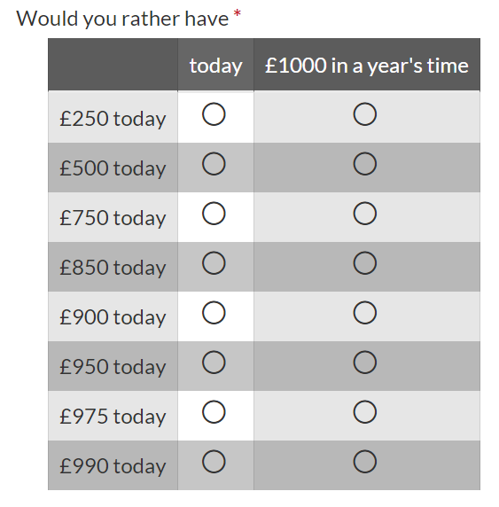
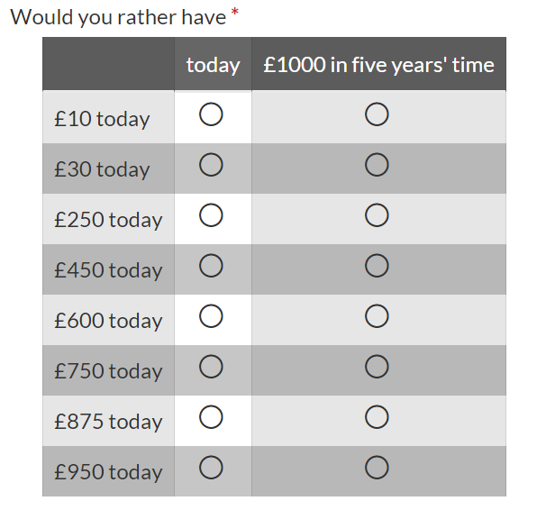
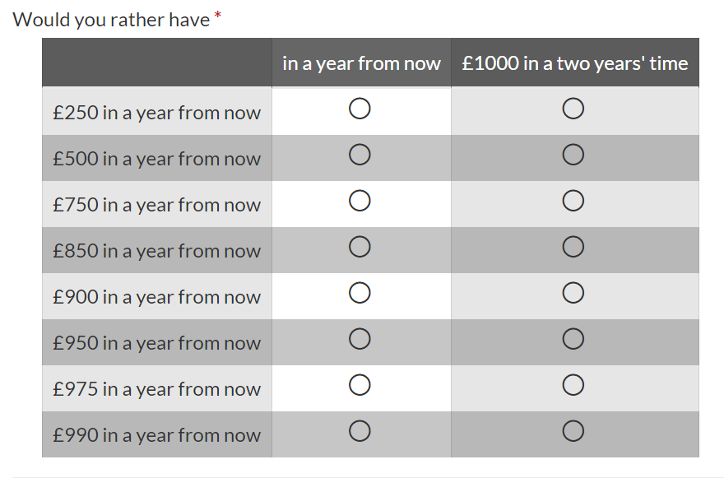
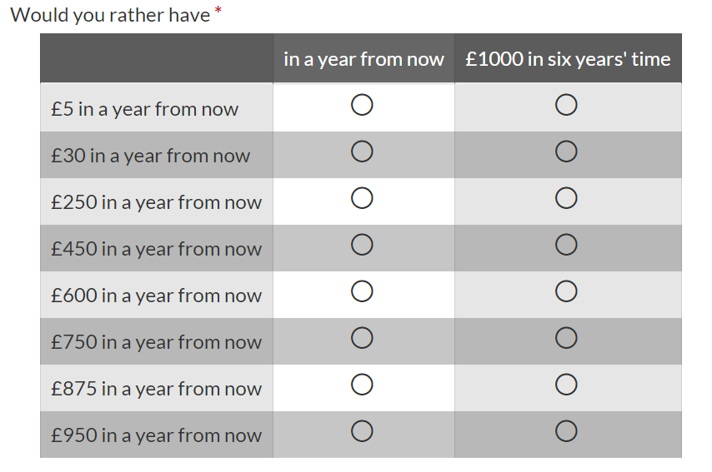

Slide 15
Inequity aversion
Fairness
How to divide a windfall among a group of people?
Equity
What is the best income distribution in a population?
For fairness, play a dictator game
I give you £10 – divide it between yourself and another

Slide 16
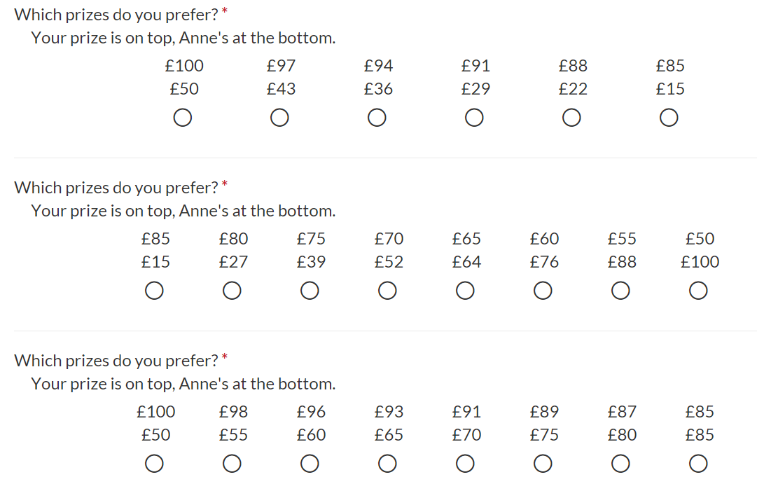

Slide 20
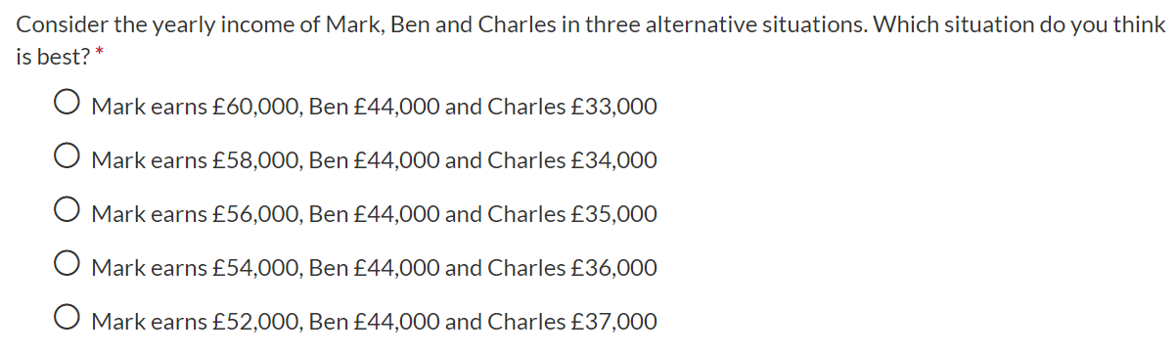
Inequity aversion
Fairness
How to divide a windfall among a group of people?
Equity
What is the best income distribution in a population?
Choice experiment with leaky bucket

Slide 21
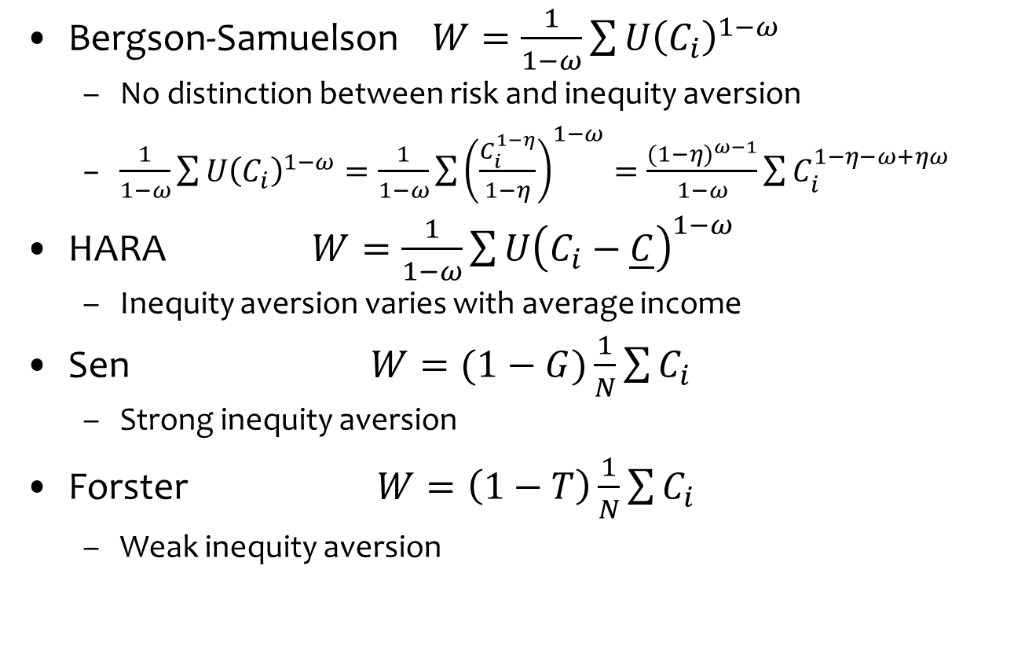
Inequity aversion
Bergson-Samuelson $W=\frac{1}{1−ω}\sum{{U\left(C_{i}\right)}^{1−ω}}$
No distinction between risk and inequity aversion
$\frac{1}{1−ω}\sum{{U\left(C_{i}\right)}^{1−ω}}=\frac{1}{1−ω}\sum{{\left(\frac{C_{i}^{1−η}}{1−η}\right)}^{1−ω}}=\frac{{(1−η)}^{ω−1}}{1−ω}\sum{C_{i}^{1−η−ω+ηω}}$
HARA $W=\frac{1}{1−ω}\sum{{U\left(C_{i}−\underline{C}\right)}^{1−ω}}$
Inequity aversion varies with average income
Sen $W=(1−G)\frac{1}{N}\sum{C_{i}}$
Strong inequity aversion
Forster $W=\left(1−T\right)\frac{1}{N}\sum{C_{i}}$
Weak inequity aversion

Slide 24
Wrap-up
Experiments and surveys reveal a lot about our attitudes towards risk, time, others
But not necessarily in a tidy way that neatly fits our theory

